Slide 1
How to do a quick search in PharmaPendium?
Retrieving information from PharmaPendium
Marnix Wieffer, Senior marketing manager
Notes:
Hello everybody and welcome to this training video, where I will show you how to do a quick search in PharmaPEndium

Slide 2
Learning objective
Basic quick search
Wildcard
Exact phrase searches
Boolean operators
At the end of this video you should have a good understanding how to use the quick search function.
Enable you to retrieve data relevant for you using quick search
Notes:
During this training session I will first show you a basic quick search example, then I will show you how to enrich your search wildcard, Exact phrase searches and Boolean operators
At the end of this video you should have a good understanding how to use the quick search function.
Enable you to retrieve data relevant for you using quick search

Slide 3
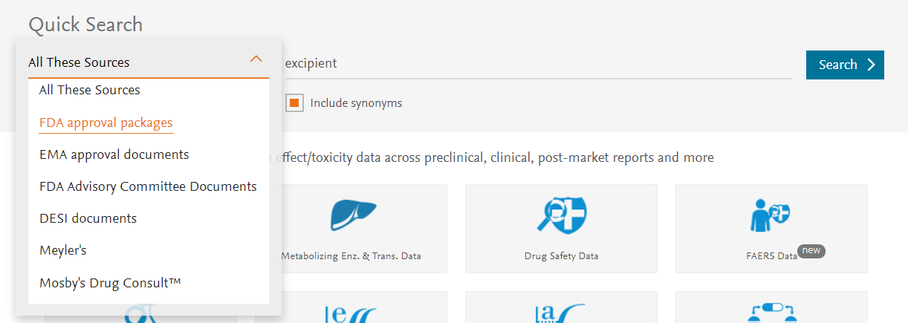
Selecting sources: Quick search
Full PharmaPendium document base
For example: In what FDA advisory committee meetings are excipients being discussed
For more detail watch the “How to do a quick text search in PharmaPendium?” video
Notes:
Using the Quick search feature we can search the PharmaPendium document base in full text. These include FDA approval packages, EMA approval packages, FDA advisory committee meeting documents, DESI document, Meyler’s abd Mosby’s drug consult. Now, especially FDA regulatory documents are often scanned image files and finding relevant information is notoriously hard. We have made all those documents text searchable and we can discover relevant content easily using quick search. For example, we can ask ourselves the question, what FDA advisory committee meeting document specifically

Slide 4
Wildcard, Exact phrases and Operators
Wild cards
Single letter truncations use “?”
Excipient?, Analy?e
Multi character truncation use “*”
Cyp3*, Phosphory*, h*emoglobin
Boolean operators
AND, OR and NOT
“anti-drug antibody” AND immunoassay
Exact phrase searches
Boolean Operators are not case sensitive
Parentheses are needed in some cases
When using the NOT operator you must put an AND before the NOT
Use double-quotes to retrieve exact terms/phrases
“Acute Myeloid leukemia”
https://service.elsevier.com/app/answers/detail/a_id/5211/supporthub/pharmapendium/
Notes:
Let take a look how we can expand or refine our searches using Wildcards, Exact phrase searches and Boolean operators. We just looked for the word excipient in FDA advisory committee meeting documents. That search retrieved 193 records. Maybe we would also like to retrieve documents where the plural form is being mentioned, so Excipients. For this we can easily use the question mark ,which is a single letter truncation wild card. The question mark can be any single character.
Often you would like to broaden a particular concept for example you could be interesed not only in Phosphorylate, but also phosphorylation, phosphorylated. Or maybe all mentioning of all variants of Cyp3. For these searches we can use the asterisk. Where the asterisk means as a multi-character wildcard
Next, concepts of interest often consist of multiple words. For example Acute myeloid leukemia or heart attack. If we would simply acute Myeloid leukemia n the quick search bar pharmapendium would look for the term Heart and teh term attack, not necessarily as a singel concept. So if you are interestd in herta attcak you would like to make sure that the exact text is found. We can do this by placing our phrase between quotation marks> let’s take a look at what the effect is.
So let place heart attack between quotation marks. Please also note that I leave the “Include synonyms” box checked”. In the results we can see that we only find Heart attack as an exact match. Interestingly, I also we also find synonyms of heart attack like myocardial infarction. PharmaPendium now also looked for known synonyms. By clicking on the number of search results in the left upper corner we can see the original query and the synonyms that were included. We can also manually modify the query and rerun the search.
Last, to further optimize your quick search we can also include Boolean operators. AND means that both terms should be present in the document. OR means either of the terms should be present in the document, Not means the first term should be present, the second term should be absent. For various specific rules and example how we can combine these different operators I would like to refer you to the help section on Boolean operators in the PharmaPendium support hub.

Slide 5
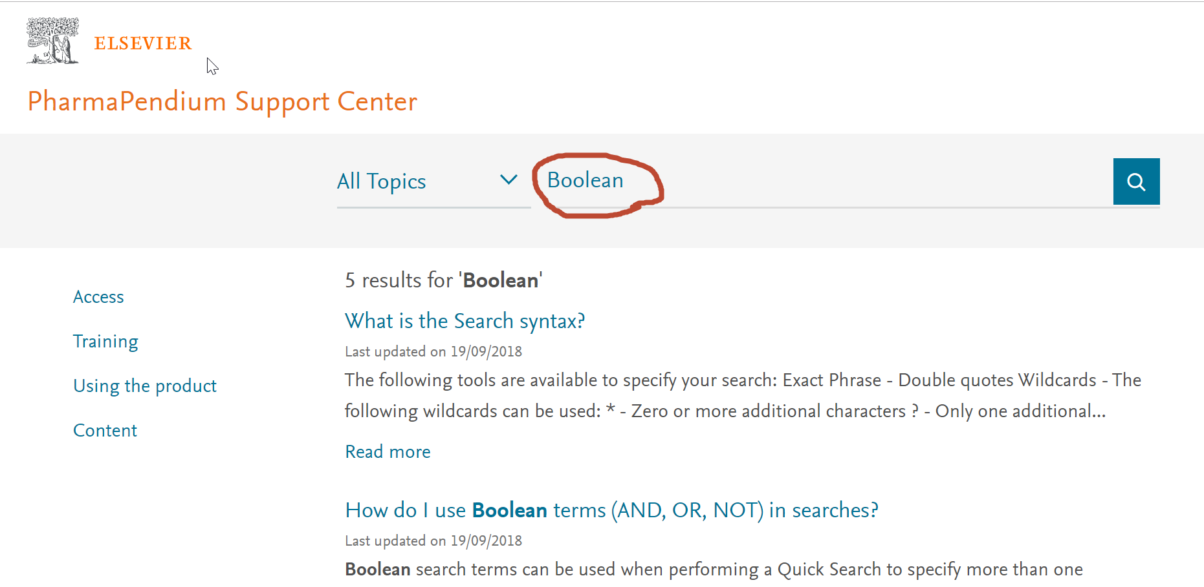
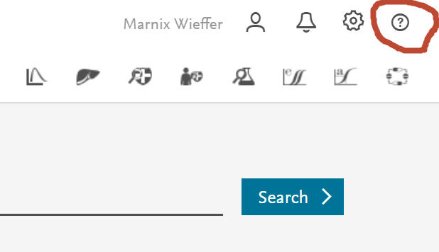
More information on Boolean operators
Notes:
Let take a look how we can expand or refine our searches using Wildcards, Exact phrase searches and Boolean operators. We just looked for the word excipient in FDA advisory committee meeting documents. That search retrieved 193 records. Maybe we would also like to retrieve documents where the plural form is being mentioned, so Excipients. For this we can easily use the question mark ,which is a single letter truncation wild card. The question mark can be any single character.
Often you would like to broaden a particular concept for example you could be interesed not only in Phosphorylate, but also phosphorylation, phosphorylated. Or maybe all mentioning of all variants of Cyp3. For these searches we can use the asterisk. Where the asterisk means as a multi-character wildcard
Next, concepts of interest often consist of multiple words. For example Acute myeloid leukemia or heart attack. If we would simply acute Myeloid leukemia n the quick search bar pharmapendium would look for the term Heart and teh term attack, not necessarily as a singel concept. So if you are interestd in herta attcak you would like to make sure that the exact text is found. We can do this by placing our phrase between quotation marks> let’s take a look at what the effect is.
So let place heart attack between quotation marks. Please also note that I leave the “Include synonyms” box checked”. In the results we can see that we only find Heart attack as an exact match. Interestingly, I also we also find synonyms of heart attack like myocardial infarction. PharmaPendium now also looked for known synonyms. By clicking on the number of search results in the left upper corner we can see the original query and the synonyms that were included. We can also manually modify the query and rerun the search.
Last, to further optimize your quick search we can also include Boolean operators. AND means that both terms should be present in the document. OR means either of the terms should be present in the document, Not means the first term should be present, the second term should be absent. For various specific example how we can combine these different operators I would like to refer you to the help section on Boolean operators in the PharmaPendium support hub,
This is of course critical information that will help companies to address regulatory concerns early on. This will help to avoid reinvent the wheel helping to save time and resources and reduce risk. PharmaPendium is the only tool that can retrieve this information as we made these scanned FDA documents text searchable in full text, and where you can search across different regulatory agencies as well as drug classes in a single search.

Slide 6
Notes:
With that I would like to thank you for your attention. I case of quetsions, please do not hesitate to get in touch.

